Slide 2
MongoDB - Embedded Documents
MongoDB provides you a cool feature which is known as Embedded or Nested Document. Embedded document or nested documents are those types of documents which contain a document inside another document. Or in other words, when a collection has a document, this document contains another document, another document contains another sub-document, and so on, then such types of documents are known as embedded/nested documents.

Slide 3
Notes -
In MongoDB, you can only nest document up to 100 levels.
The overall document size must not exceed 16 MB.

Slide 4
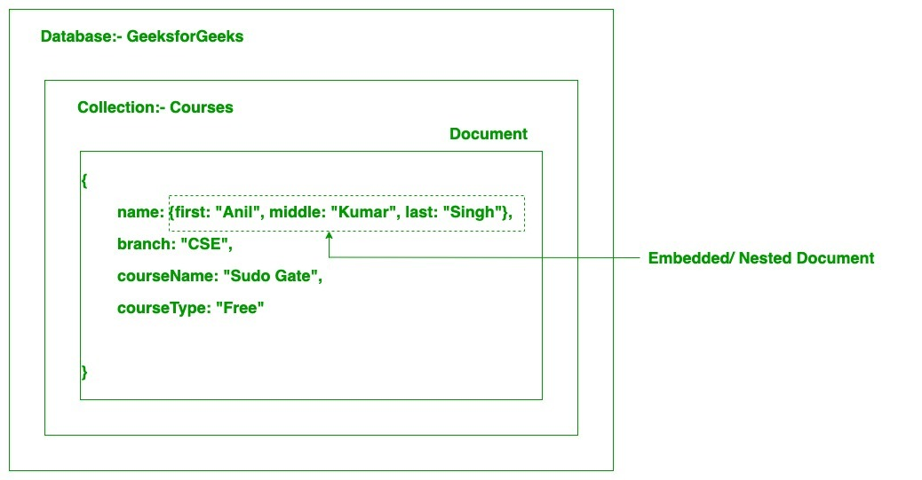

Slide 5
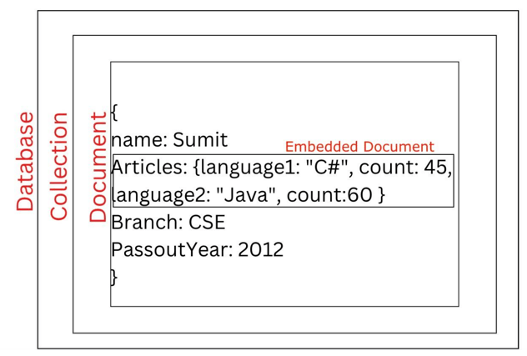

Slide 6
https://dotnettutorials.net/lesson/embedded-documents-in-mongodb/
Example 1: db.embeddedColl.insertOne({ name: “Sunita”, Articles:{lang1:”C#”, count:45, lang2:”Java”, count:87, lang3:”C”, count:78}, Branch: “CSE”, PassoutYear: 2013 })
Here in the above example, we create a nested document inside the Articles field using curly braces{}. The nested document contains four field value pairs that are:
Articles:{lang1:”C#”, count:45, lang2:”Java”, count:87, lang3:”C”, count:78}

Slide 7
Example 2:
> db.embeddedColl.insertOne({ … name: “Amit”, … Articles:{lang:”C#”, count:45, type:{program:10, function:13, concept:22}}, … year:2015 … })
Here, in the above example, we create a nested document inside the Articles field, and inside this nested document, we create another nested document inside the type field using Curley braces{}.

Slide 8
Aggregation in MongoDB
Aggregation in MongoDB is a powerful framework that allows developers to perform complex data transformations, computations and analysis on collections of documents. By utilizing the aggregation pipeline, users can efficiently group, filter, sort, reshape, and perform calculations on data to generate meaningful insights.

Slide 9
What is Aggregation?
MongoDB Aggregation is a database process that allows us to perform complex data transformations and computations on collections of documents or rows. It enables us to group, filter, and manipulate data to produce summarized results. MongoDBAggregation is typically carried out using the aggregation pipeline which is a framework for data aggregation modeled on the concept of data processing pipelines.
Each stage of the pipeline transforms the documents as they pass through it and allows for operations like filtering, grouping, sorting, reshaping and performing calculations on the data. MongoDB supports two primary aggregation approaches:

Slide 10
1. Single Purpose Aggregation
Single-purpose aggregation methods are designed for simple analytical queries. It is used when we need simple access to document like counting the number of documents or for finding all distinct values in a document.
count() – Returns the number of documents in a collection.
distinct()– Retrieves unique values for a specified field.

Slide 11
2. Mongodb Aggregation Pipeline
Mongodb Aggregation Pipeline consist of stages and each stage transforms the document. It is a multi-stage pipeline and in each state the documents are taken as input to produce the resultant set of documents. In the next stage (ID available) the resultant documents are taken as input to produce output, this process continues till the last stage. Each stage filters, modifies, or computes on documents before passing them to the next stage.
The basic pipeline stages are defined below:
filters that will operate like queries.
the document transformation that modifies the resultant document.
provide pipeline tools for grouping and sorting documents.
Aggregation pipeline can also be used in sharded collection.

Slide 12
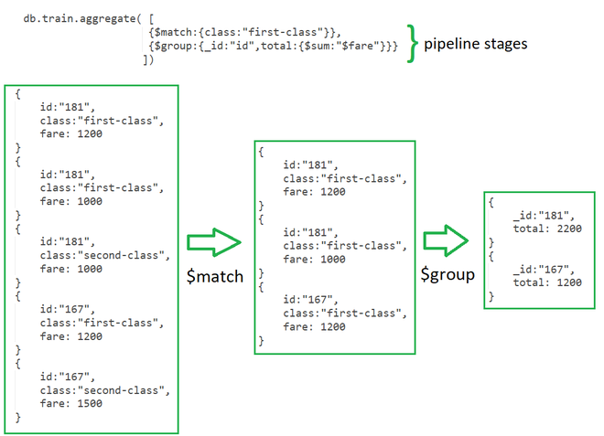

Slide 13
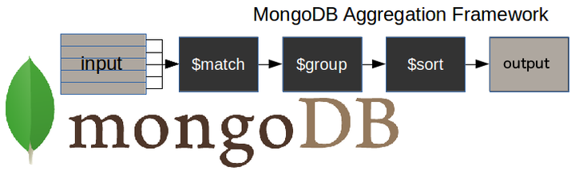
$match stage – filters those documents we need to work with, those that fit our needs
$group stage – does the aggregation job
$sort stage – sorts the resulting documents the way we require (ascending or descending)

Slide 14
The aggregate() Method
For the aggregation in MongoDB, you should use aggregate() method.
Syntax
Basic syntax of aggregate() method is as follows −
>db.COLLECTION_NAME.aggregate(AGGREGATE_OPERAT

Slide 15
db.posts.aggregate([
// Stage 1: Only find documents that have more than 1 like
{
$match: { likes: { $gt: 1 } }
},
// Stage 2: Group documents by category and sum each categories likes
{
$group: { _id: "$category", totalLikes: { $sum: "$likes" } }
}
])

